Slide 1

Visualizing Uncertainty with Chromatic Aberration
MCSc Thesis Defence
Md Rashidul Islam
10 May 2022
Examining Committee
Dr. Stephen Brooks (Supervisor)
Dr. Fernando Paulovich (Reader)
Dr. Joseph Malloch (Reader)
Dr. Dirk Arnold (Chair)

Slide 2
Contents
Background
Prior Work
Data Generation
Chromatic Aberration
Exploratory Designs
User Study Design
Quantitative Test
Conclusion
Future Work

Slide 3
Background

Slide 4
What is Uncertainty?
In practice, uncertainty is defined as doubt about something.
In digital the world, uncertainty refers to imperfect, unknown, lack of sureness or certainty in information.

Slide 5
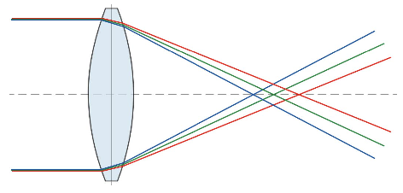
What is Chromatic Aberration?
Chromatic aberration is an effect that occurs when a lens is not able to properly refract all the wavelengths of colour in the same point.
We call Chromatic Aberration as CA throughout the talk.
Light refraction at different angles

Slide 6
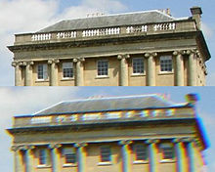
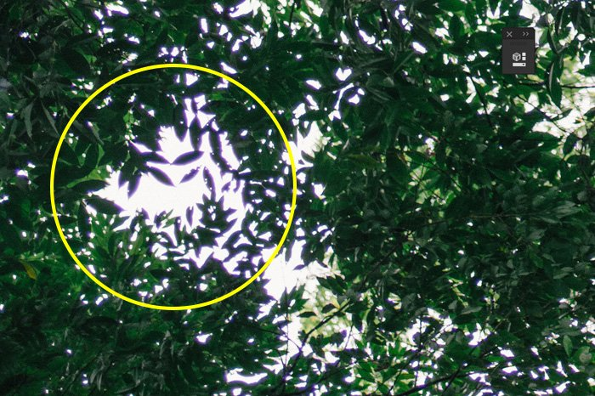
Examples of CA
Real World Chromatic Aberrations

Slide 7
Prior Work

Slide 8
Prior Work
Sathler et al. shows that Neural network models (MLP, LSTM, GRU) significantly outperforms traditional machine learning models.
Pang et al. introduced a wide variety of new uncertainty visualization methods like adding glyphs, adding geometry, modifying attributes, modifying geometry, animation and applied to many applications such as environmental visualization, surface interpolation, sonification, global illumination with radiosity, flow visualization, and figure animation.
Schneider et al. conducted research where three different uncertainty visualizations were produced: (1) forecast and uncertainty maps adjacent to one another; (2) the forecast map depicted in a color scheme, with the uncertainty shown by the transparency of the color; and (3) two maps that showed the lower and upper bounds of the forecast distribution at each location.

Slide 9
Prior Work
Koh et. al. presented a user study to observe the effect on users’ judgment with Lateral Chromatic Aberration (LCA). LCA occurs when the lens does not focus all lights with different wavelengths to the same convergent point. Human eyes and eyeglasses help to compensate it.
Johnson et al. shows that inconsistencies in lateral chromatic aberration can be used to detect tampering in visually plausible forgeries. They describe a computational technique for estimating lateral chromatic aberration by digital tampering in synthetic and real images.
Healey et al. presents a new method for using texture to visualize multidimensional data elements arranged on an underlying three-dimensional field. Perceptual texture elements are built by controlling three separate texture dimensions: height, density, and regularity.

Slide 10
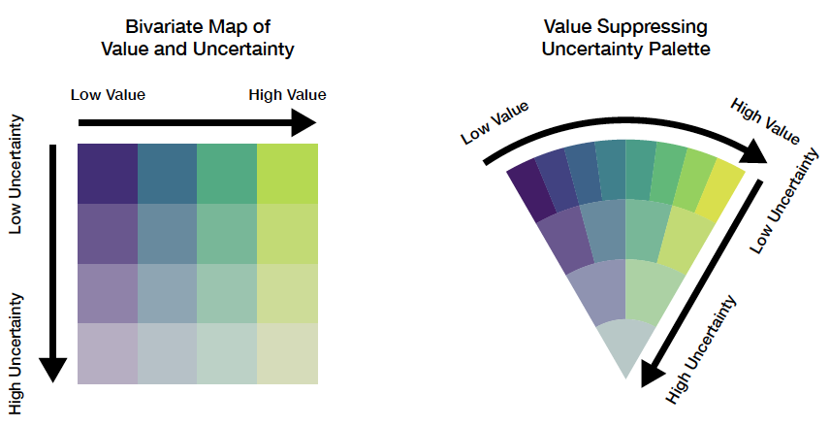
Prior Work
Bivariate Map
VSUP (Value Suppressing Uncertainty Palettes)

Slide 11
Data Generation

Slide 12
Uncertainty Data Generation Flow
Training Data
Forecasting Algorithms
Model
After Training
New Data (Optional)
Model
Predictions
Calculate Uncertainty
Data with Uncertainty

Slide 13
Predictive Algorithms
MLP (Multilayer Perceptron)
CNN (Convolutional Neural Network)
LSTM (Long-Short Term Memory)
Auto Arima

Slide 14
Uncertainty Comparison among Models
Country | MLP | CNN | LSTM | ARIMA
United States | 7.00 | 7.00 | 3.44 | 7
India | 4.28 | 0.61 | 7.00 | 3.52
Brazil | 3.64 | 0.51 | 3.24 | 1.27
Kazakhstan | 2.43 | 0.42 | 0.35 | 0.17
France | 2.15 | 0.31 | 0.81 | 0.56
Peru | 1.28 | 0.23 | 0.28 | 0.22
Germany | 1.21 | 0.19 | 0.50 | 0.51
Spain | 1.07 | 0.19 | 0.67 | 0.33
Turkey | 1.03 | 0.19 | 1.21 | 0.30
Argentina | 1.02 | 0.14 | 1.08 | 0.25

Slide 15
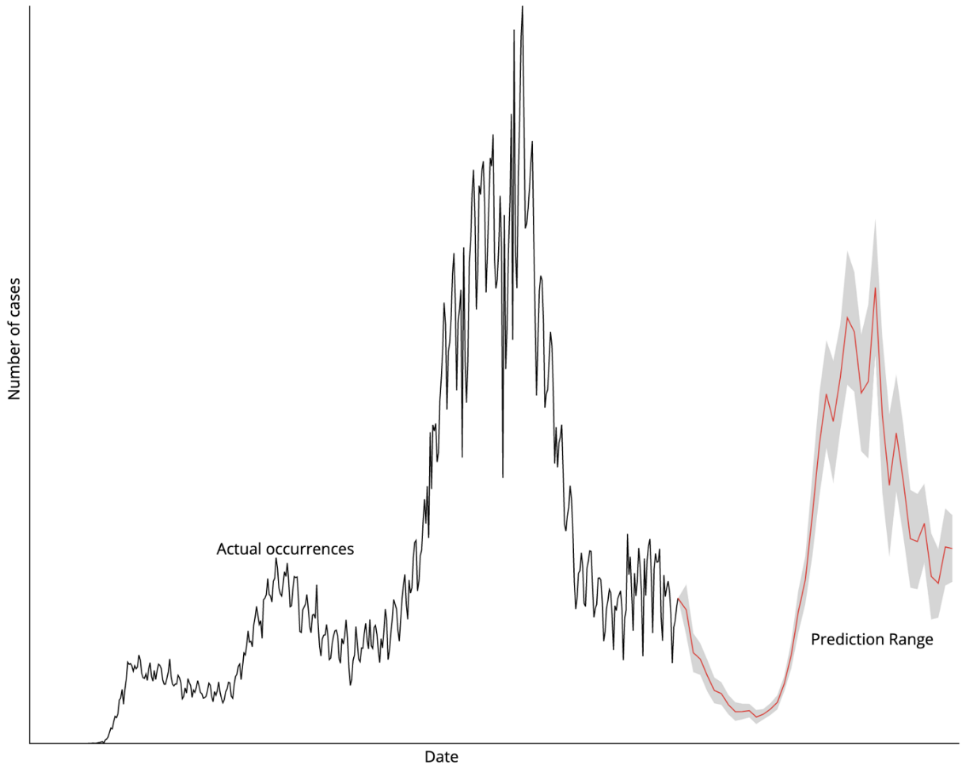
Uncertainty in Prediction

Slide 16
Chromatic Abberation

Slide 17
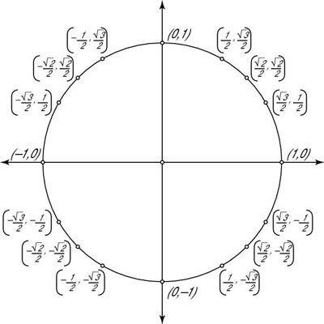
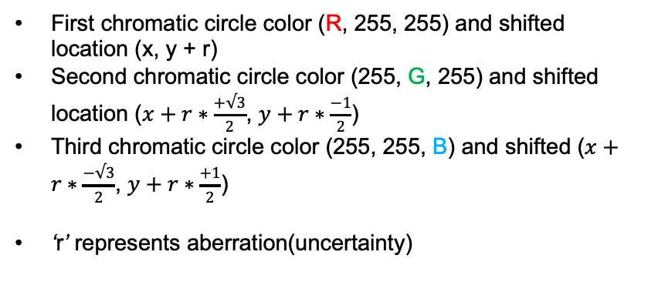
Architecture of CA
First chromatic circle color (R, 255, 255) and shifted location (x, y + r)
Second chromatic circle color (255, G, 255) and shifted location ($x+r∗\frac{+√3}{2}$, $y+r∗\frac{−1}{2}$)
Third chromatic circle color (255, 255, B) and shifted ($x+r∗\frac{−√3}{2}$, $y+r∗\frac{+1}{2}$)
‘r’ represents aberration(uncertainty)
(x, y)

Slide 18


CA on a Circle
Three overlapping circles filled by rgb (100, 255, 255), rgb (255, 149, 255), rgb (255, 255, 180)
Used mix-blend-mode to darken

Slide 19
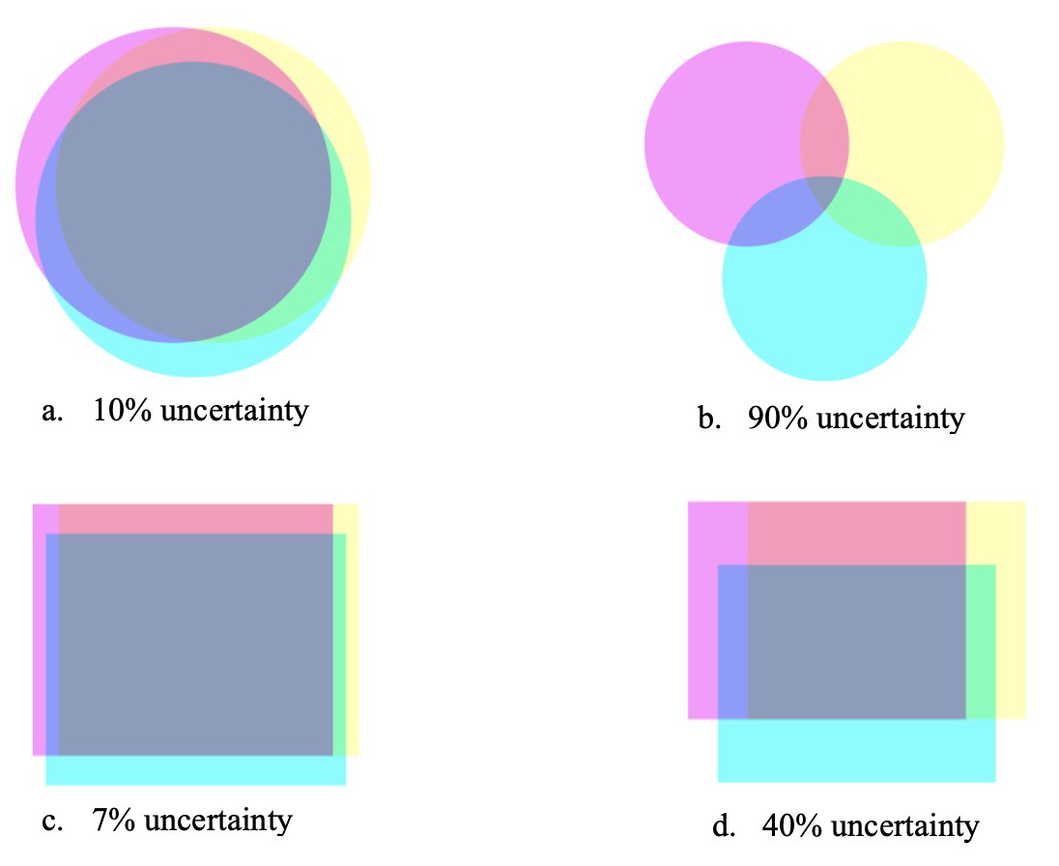
More Examples of CA Shapes

Slide 20
Exploratory Designs

Slide 21
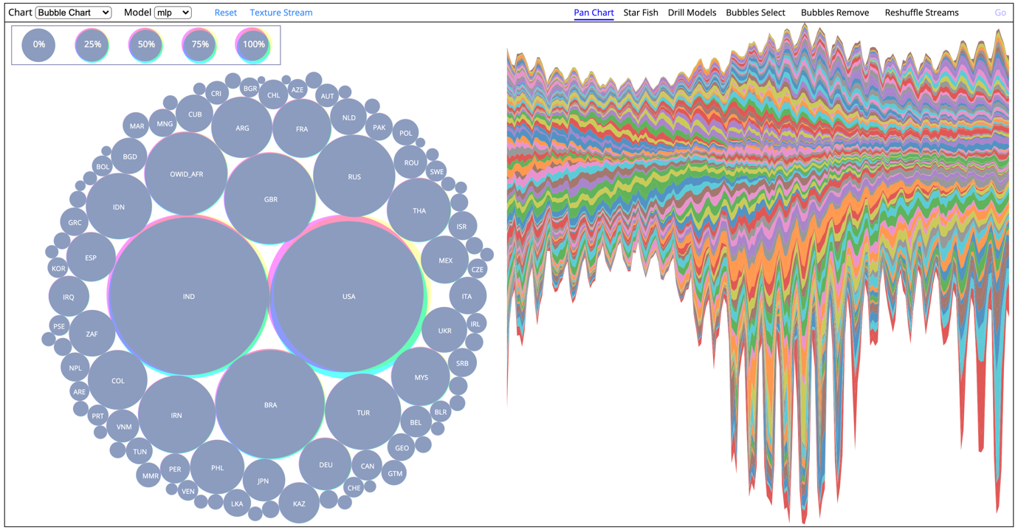
Web Interface

Slide 22
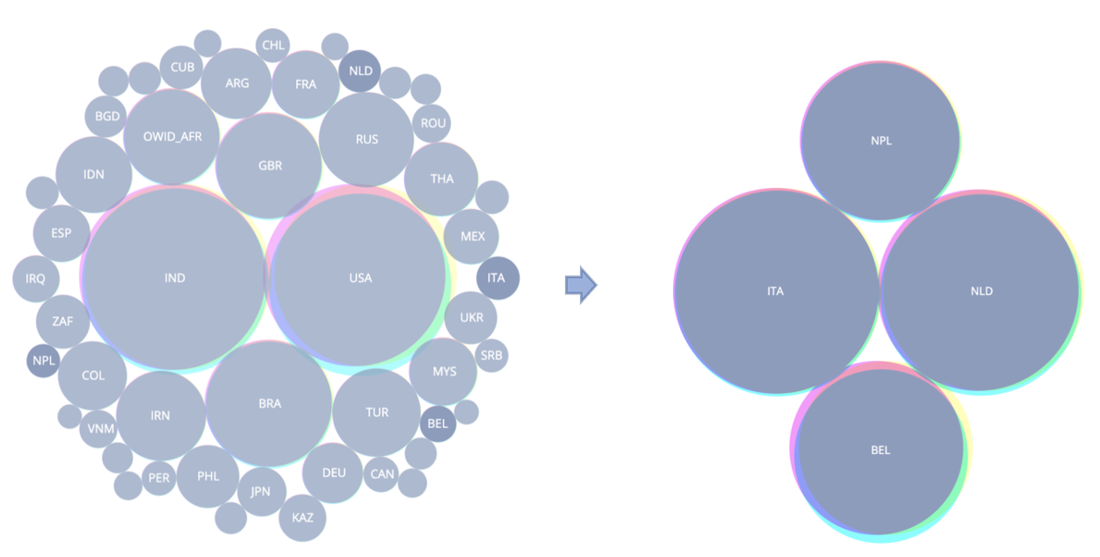
Filtering
By selected countries of interest
Side by side comparison

Slide 23
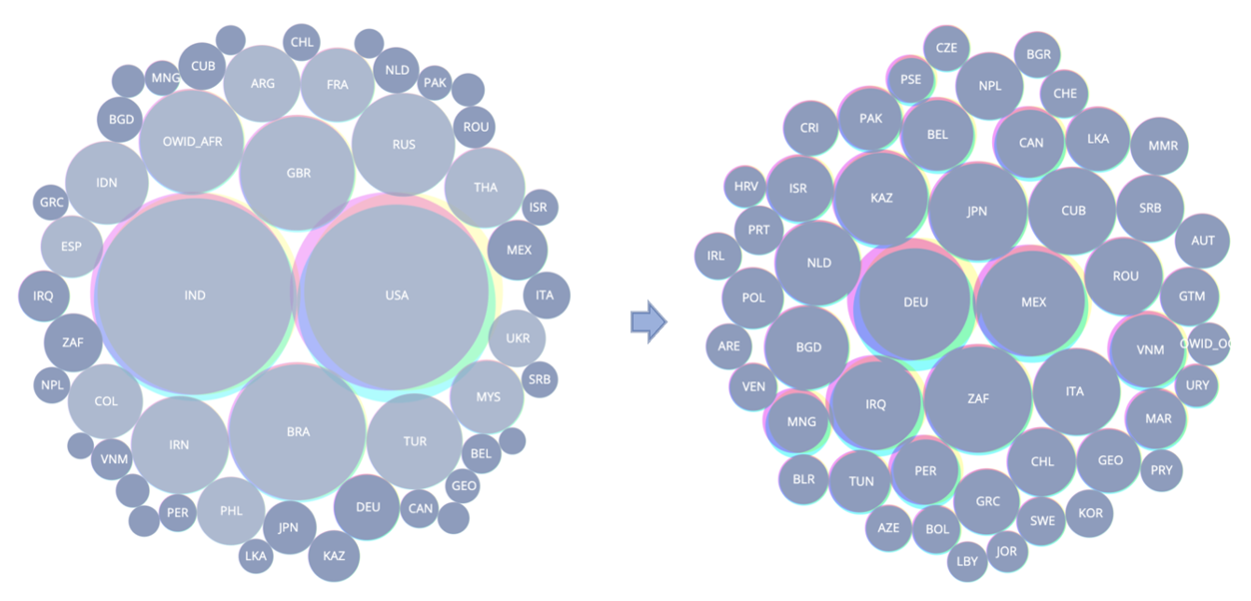
Filtering
Remove countries of interest
Comparison among rest of the countries

Slide 24
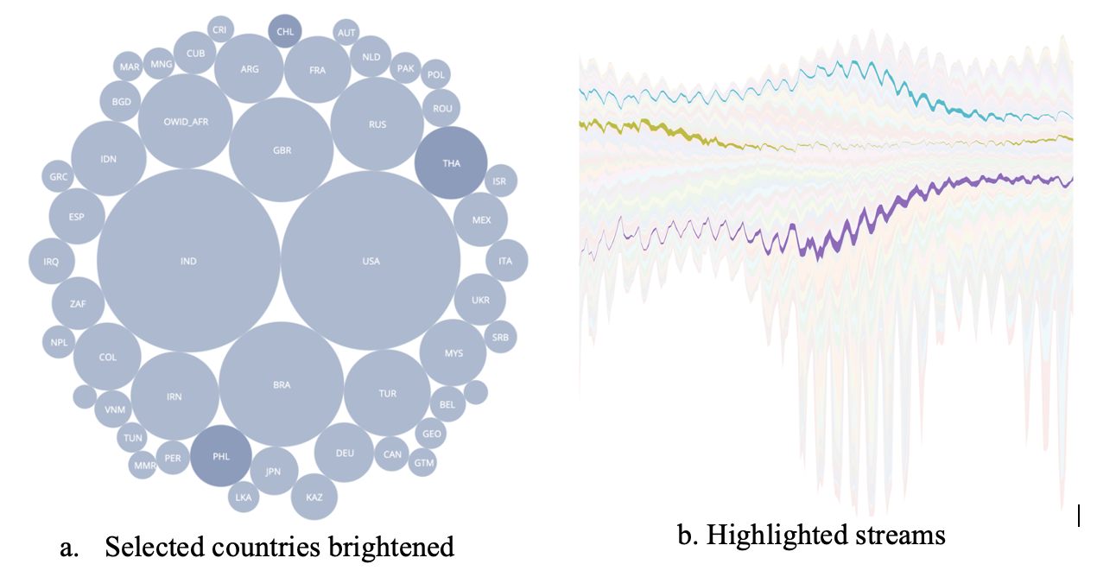
Reshufling Streams
Highlighted selected countries

Slide 25
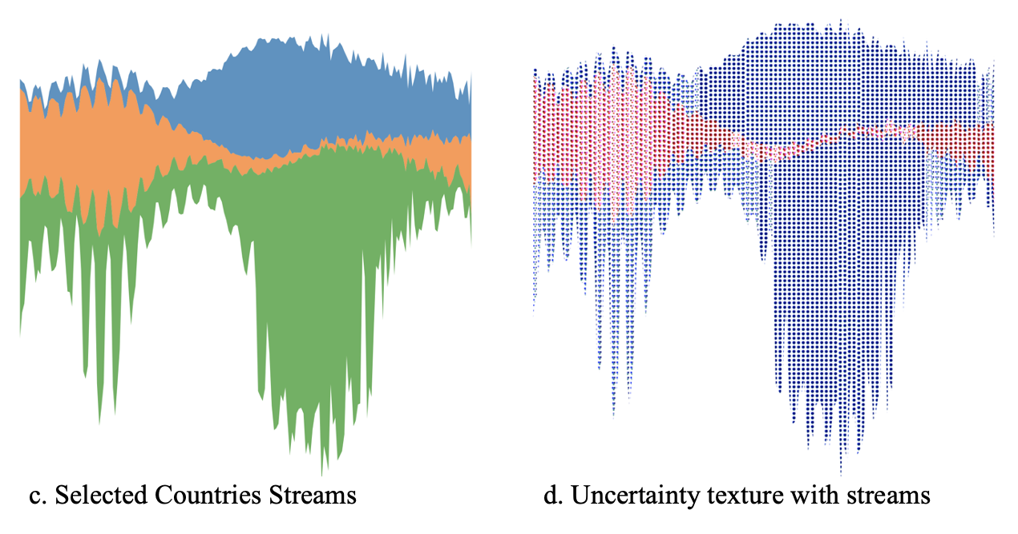
Reshufling
Side by side uncertainty comparison among three selected countries.

Slide 26
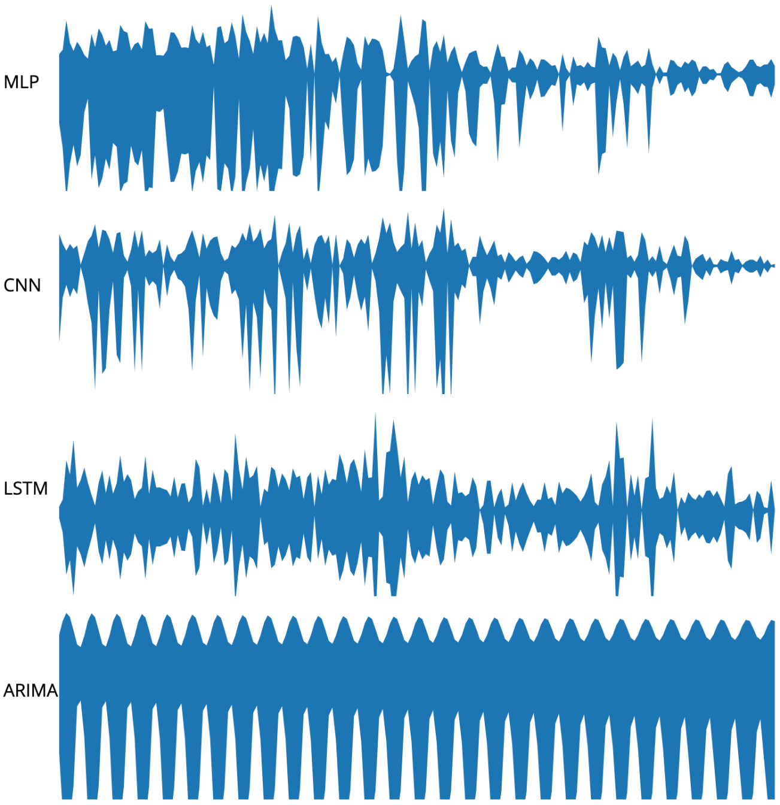
Drill-down
Prediction streams for Brazil with four models.

Slide 27
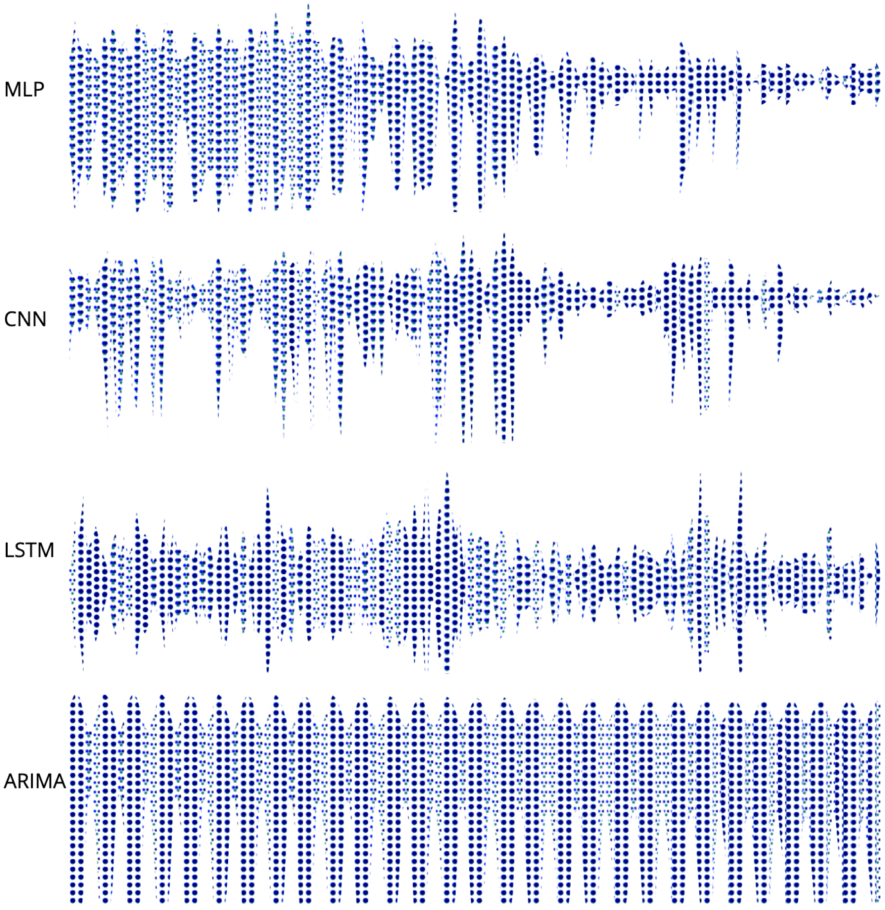
Drill-down
Side by side uncertainty comparison among four model predictions
Each column represents an uncertainty in the range 1-9

Slide 28
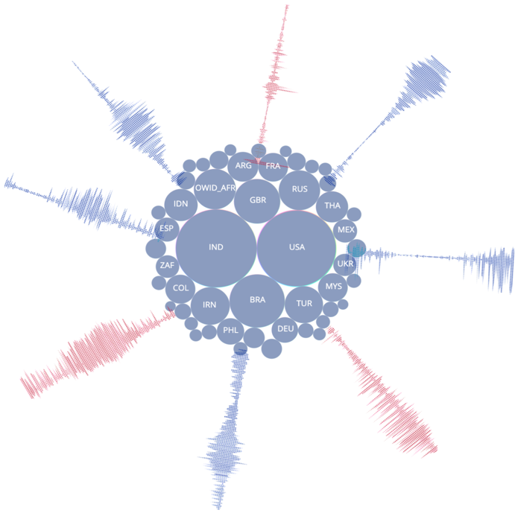
Star-Fish Layout
Side by side uncertainty comparison among four model predictions

Slide 29
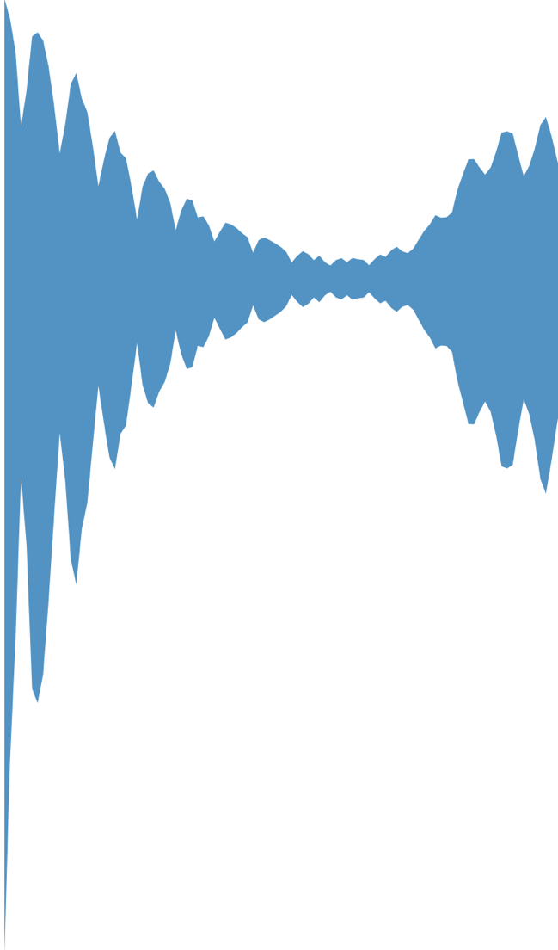
Streamgraph
Flow of number of new cases for a country.
From perdiction data of a certain period of time.

Slide 30
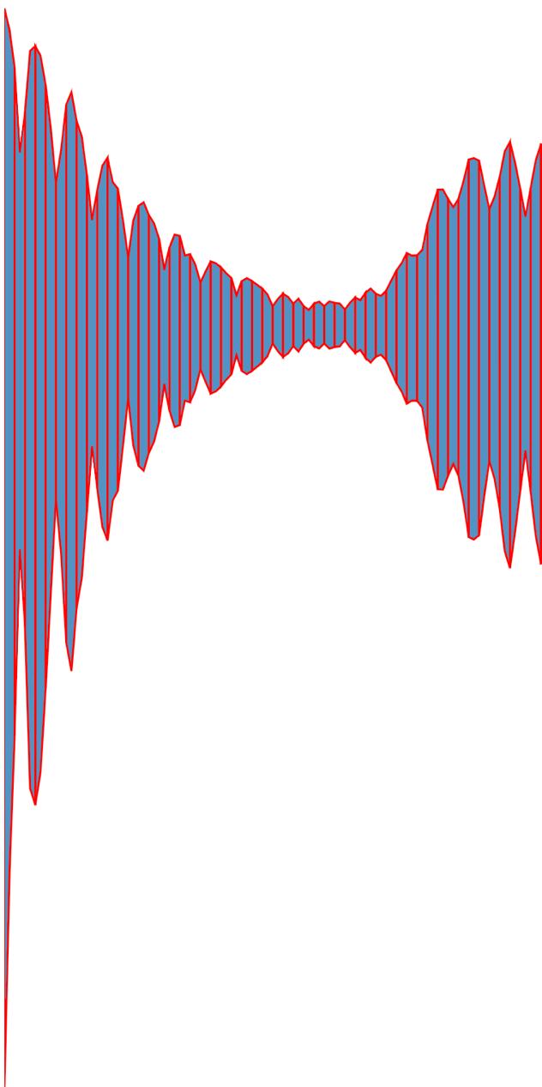
Streamgraph Slicing
Averaging every three consecutive days.

Slide 31
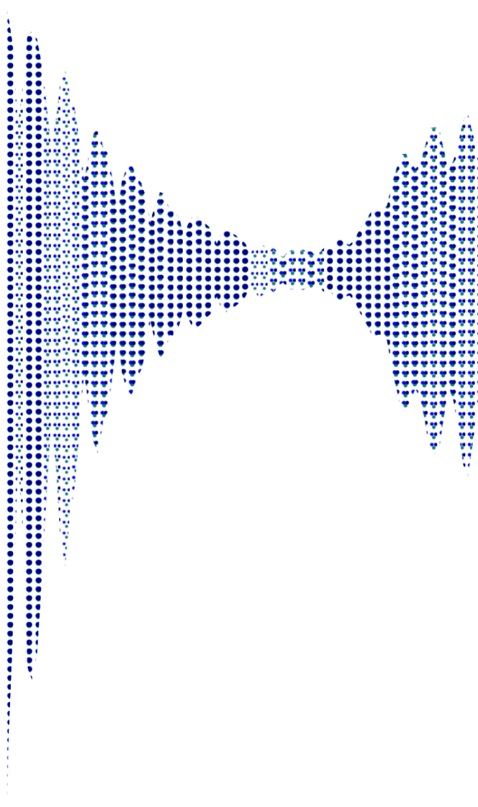
Streamgraph with CA
Assigning texture pattern to every slice.
Every slice has different amount of uncertainty (CA).

Slide 32
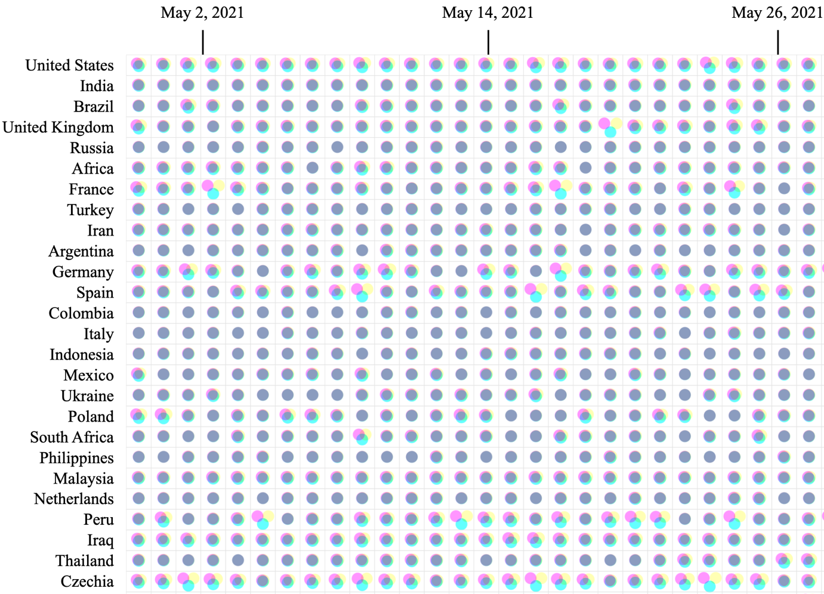
Circle Grid Chart
Each cell represents a certain amount of CA in the scale range of 1-9.
Size of circles are same by considering counts are same.

Slide 33
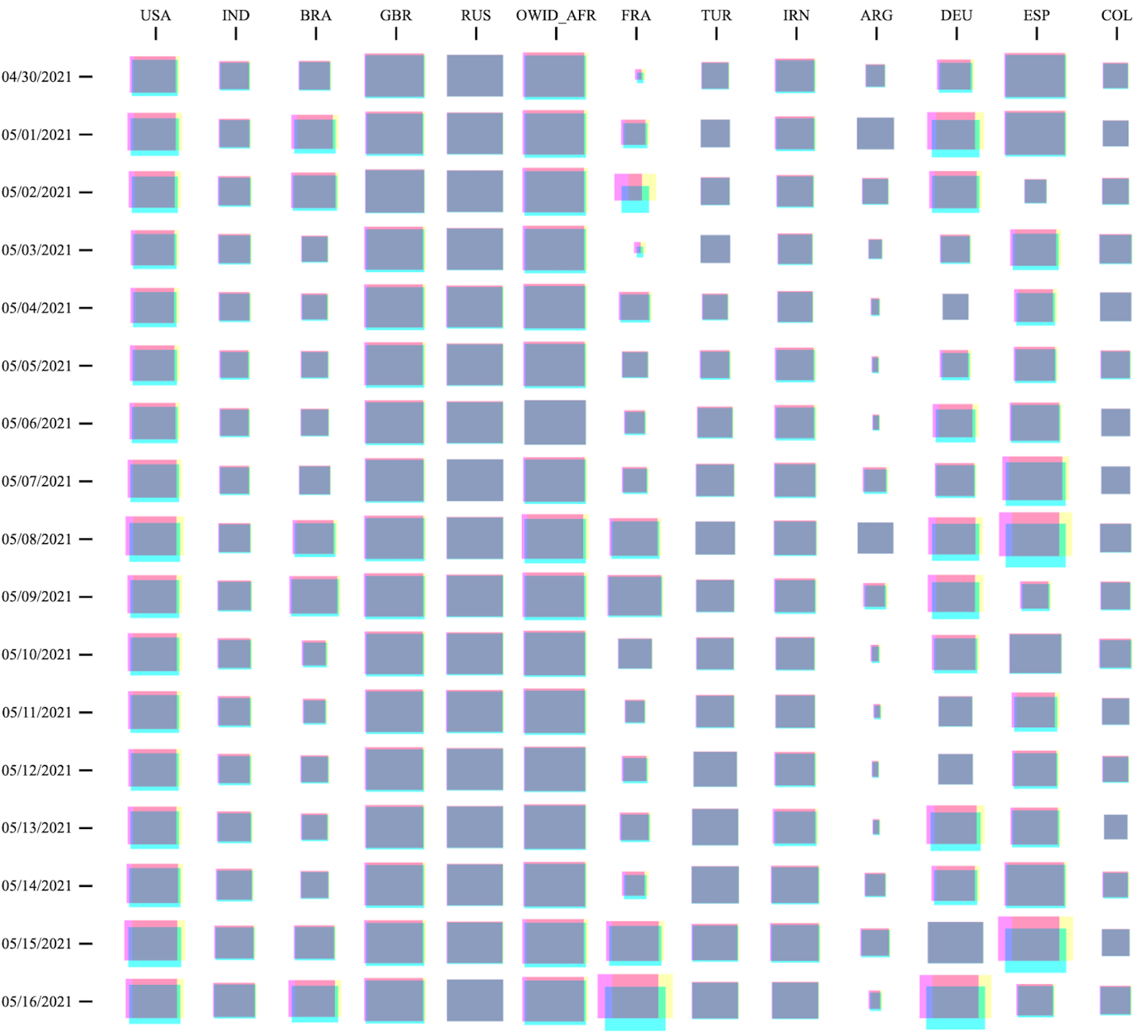
Square Grid Chart
Each cell represents a certain amount of CA in the scale range of 1-9.
Count is represented by size.

Slide 34
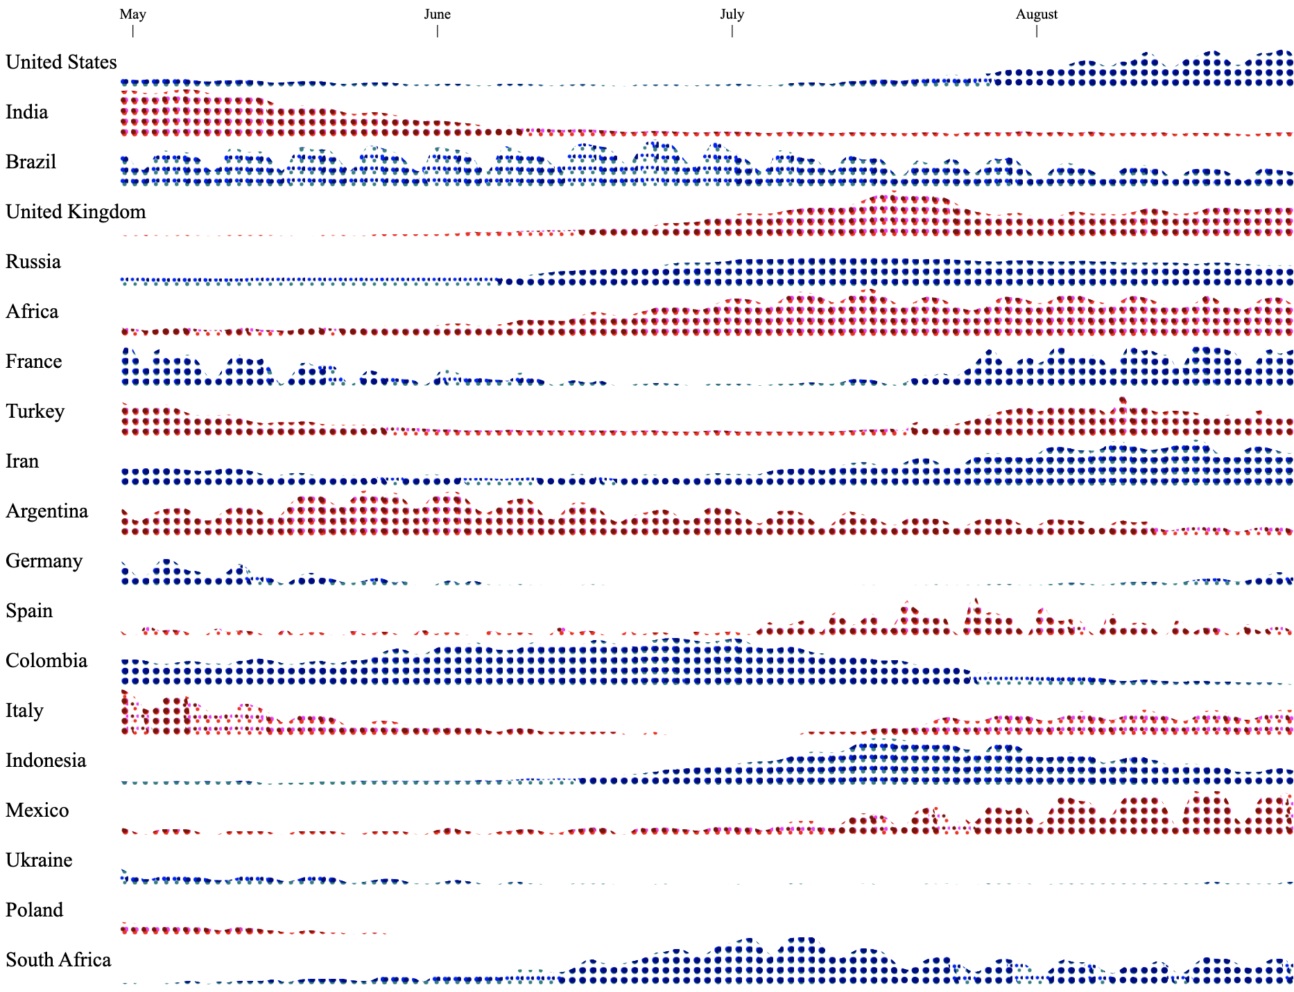
Horizontal Chart
Every country is kind of stream graph.
Every 3 consecutive days refers to a column

Slide 35
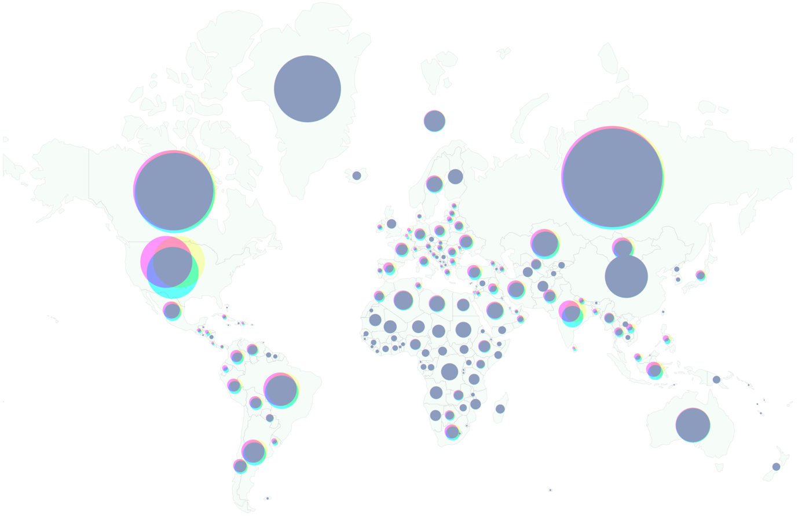
World View

Slide 36
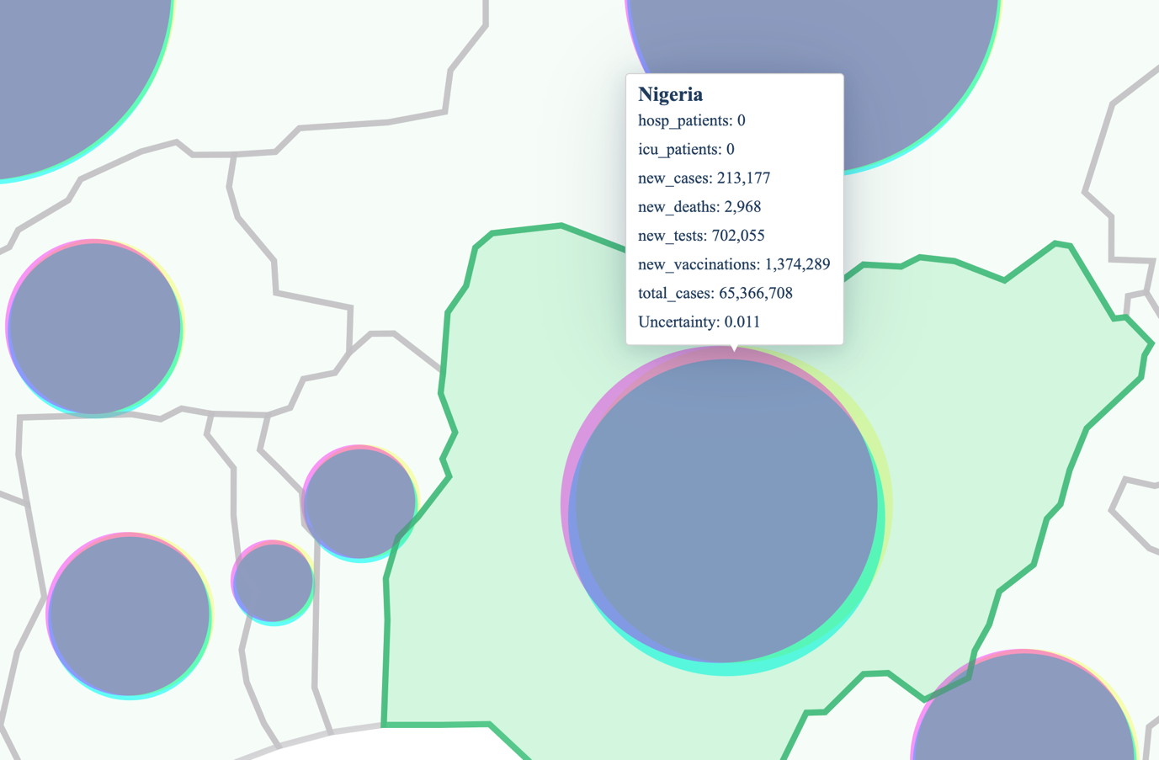
Zoomed view

Slide 37
User Study

Slide 38
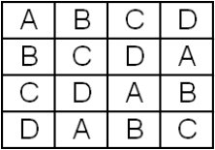
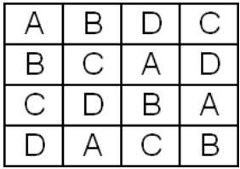
Counter Balancing
To balance learning effect of within-subject design
Marked Bs has higher learning tendency
Latin Square Balanced Latin Square

Slide 39
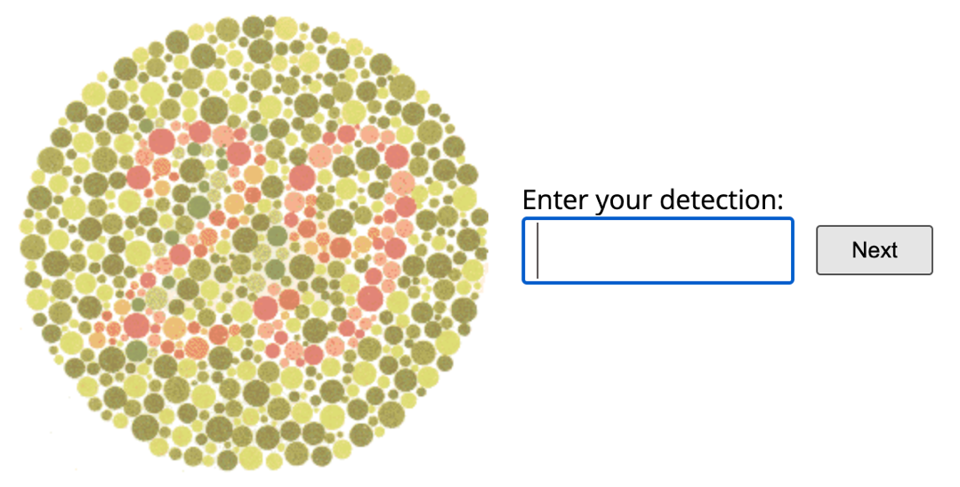
Color Blindness Test

Slide 40
Components of the Study
CA + Bubble
CA + Grid
VSUP + Bubble
VSUP + Grid

Slide 41
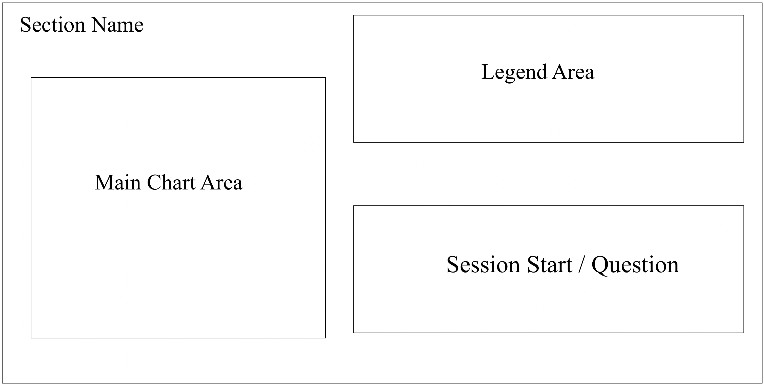
Questionnaire Layout

Slide 42
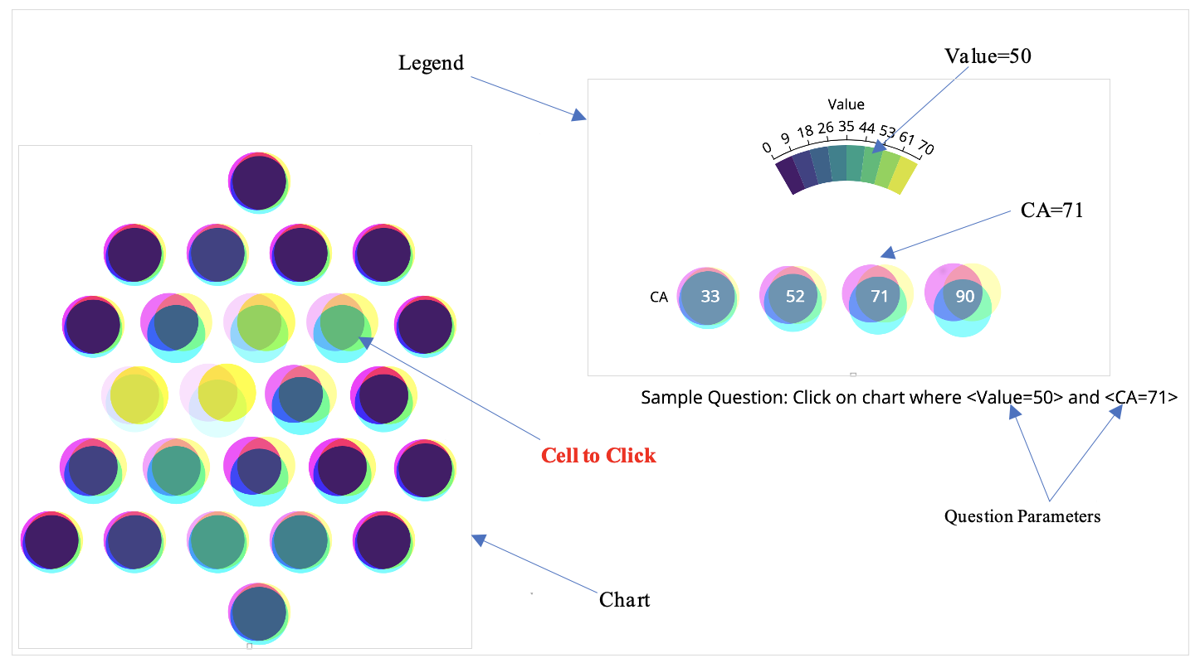
CA + Bubble

Slide 43
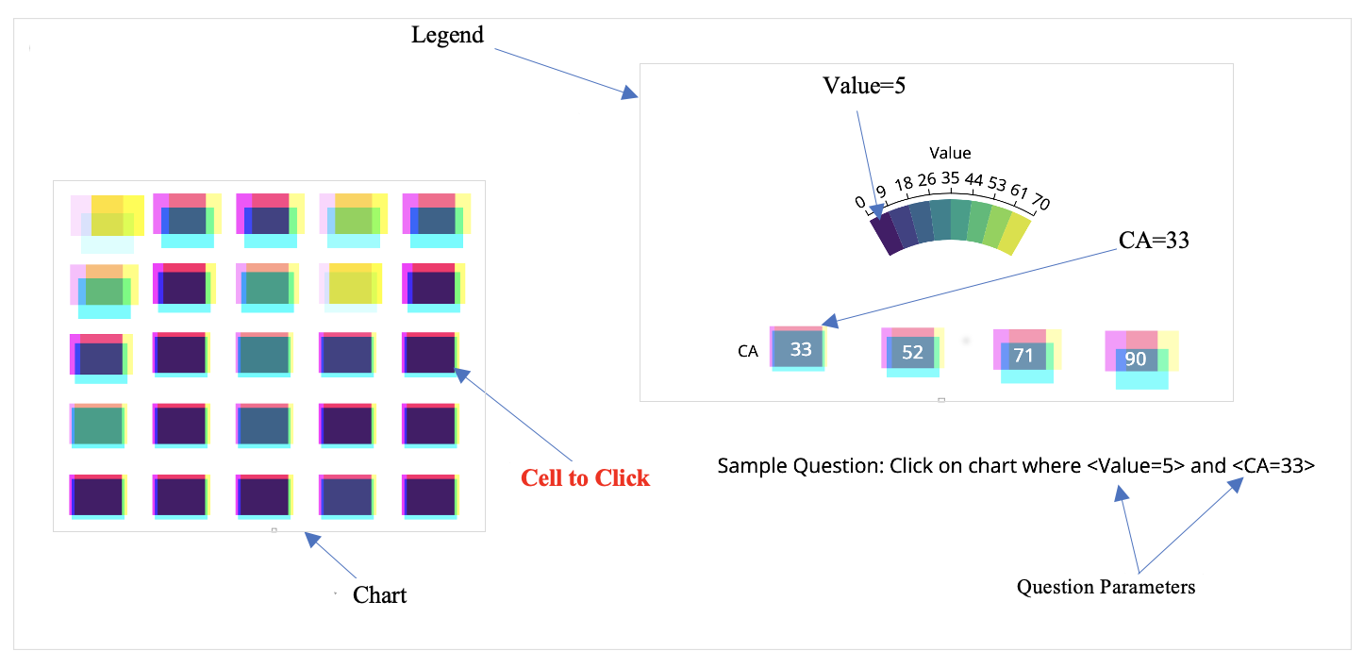
CA + Grid

Slide 44
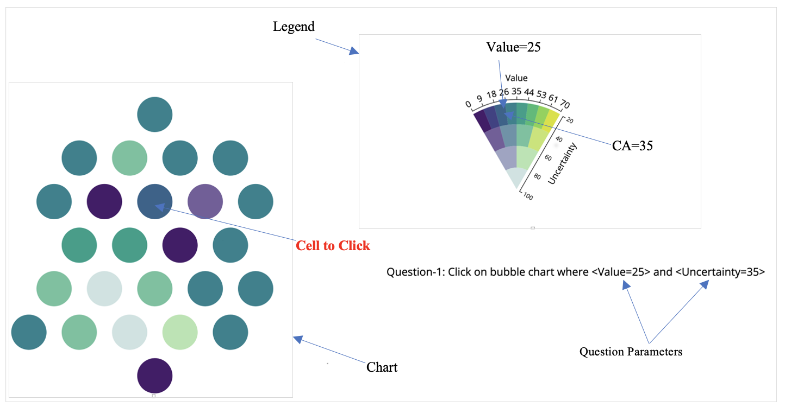
VSUP + Grid

Slide 45
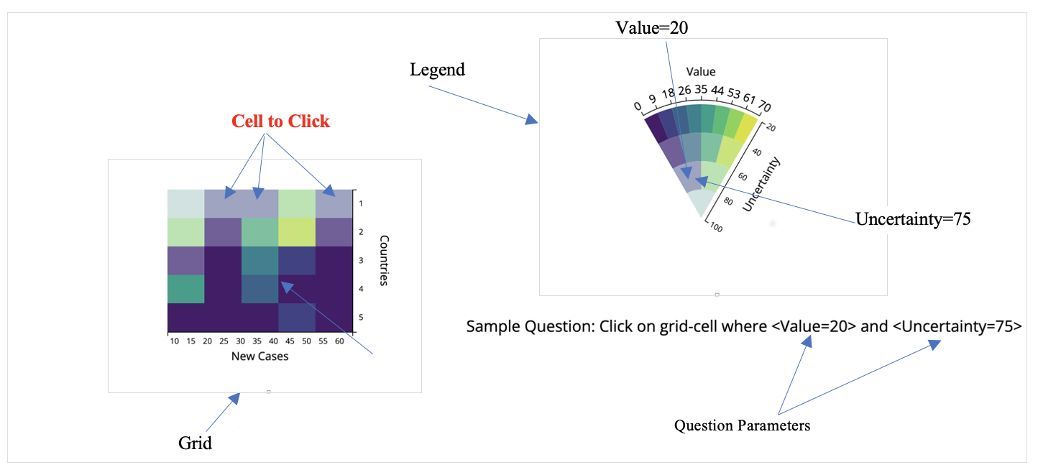
VSUP + Grid

Slide 46
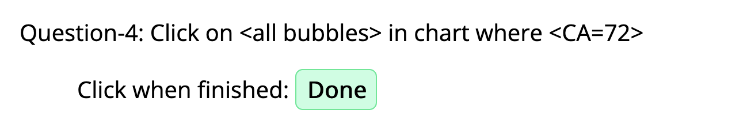
Type of Questions
Single Variable and Single Answer
Single Variable and All Answer
Double Variables

Slide 47
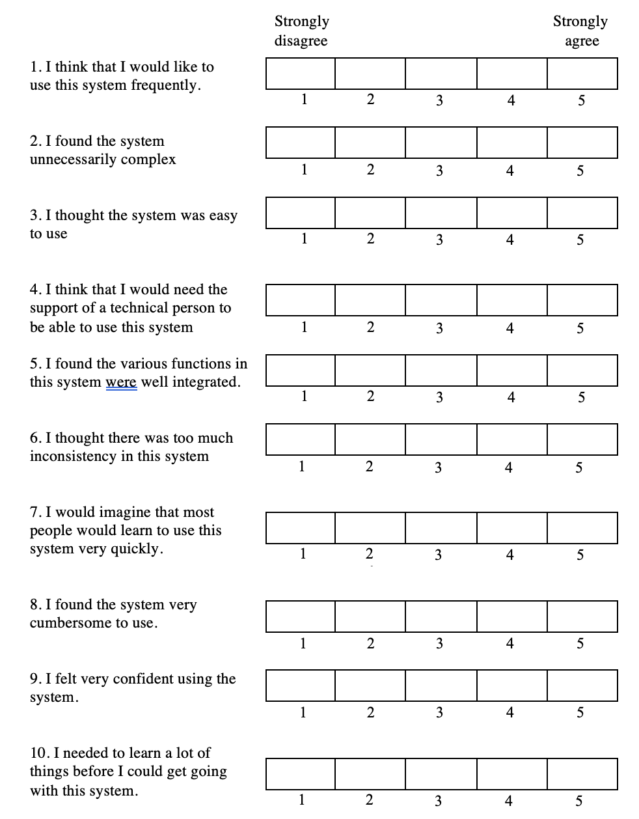
SUS Questions

Slide 48
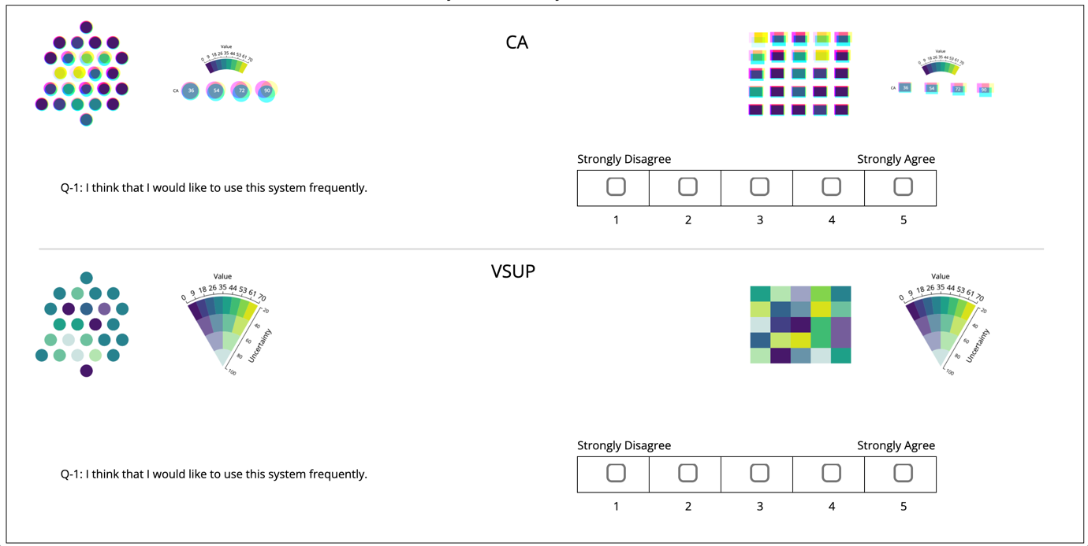
SUS Question Interface

Slide 49
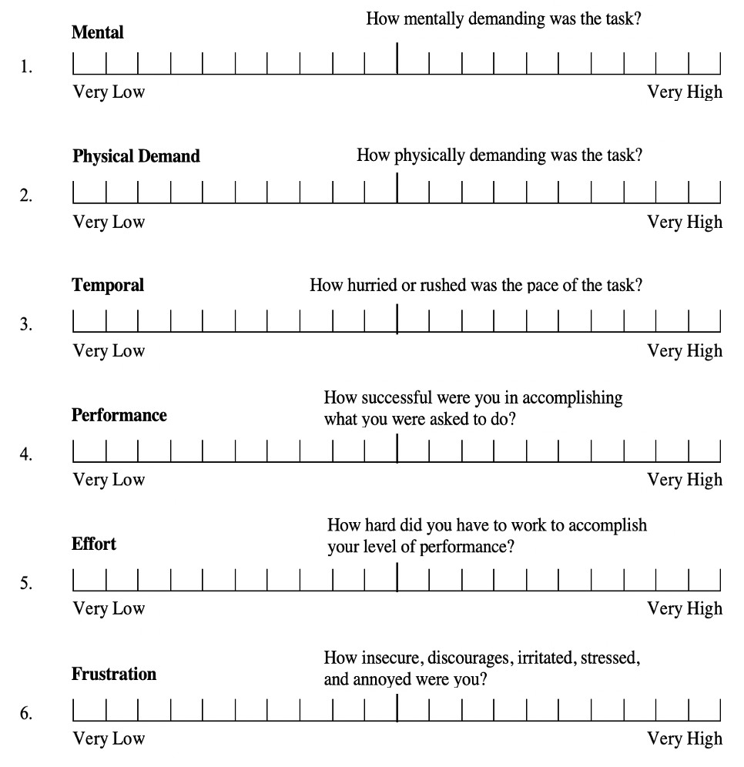
NASA-TLX Questions

Slide 50
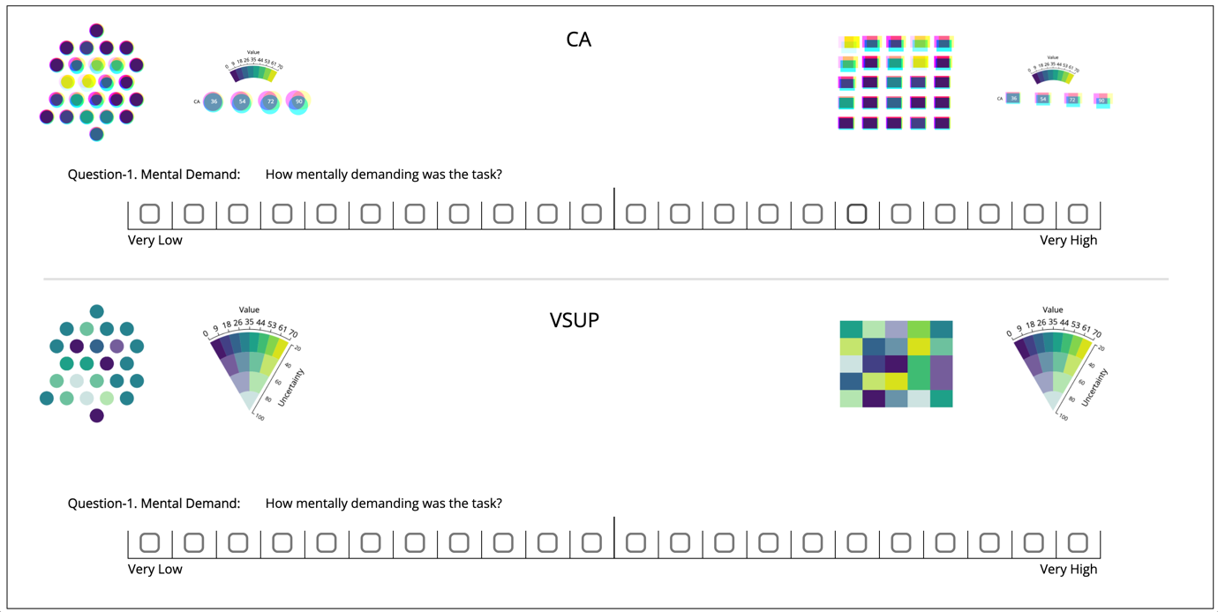
NASA-TLX Question Interface

Slide 51
Results

Slide 52
Quantitative Questionnaire
Groups | N | Mean | Std. Dev. | Variance | Std. Error.
CA + Bubble | 32 | 6.2813 | 1.301 | 1.692 | 0.23
CA + Grid | 32 | 5.5938 | 1.2916 | 1.668 | 0.2283
VSUP + Bubble | 32 | 5.6563 | 1.4053 | 1.975 | 0.2127
VSUP + Grid | 32 | 5.1875 | 1.2032 | 1.456 | 0.2127
ANOVA Data summary
The results of a one-way ANOVA is considered reliable if
Samples are independent
Variances of populations are equal
Response variable is normal

Slide 53
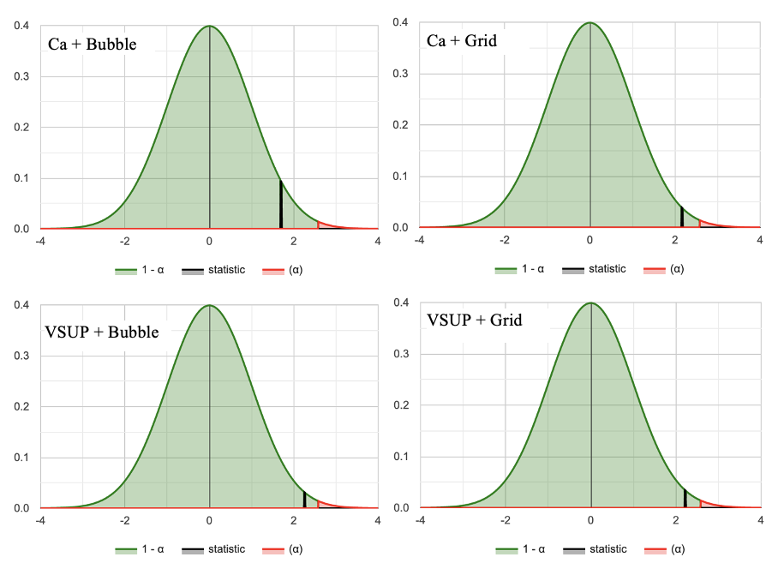
Normality Test
Component | W | P | Status
Ca + Bubble | 0.915 | 0.015 | Normal
Ca + Grid | 0.932 | 0.045 | Normal
VSUP + Bubble | 0.911 | 0.012 | Normal
VSUP + Grid | 0.913 | 0.013 | Normal
Shapiro-Wilk Test
Normal Distributions Graphs

Slide 54
ANOVA Test
Null and Alternative Hypotheses:
Ho: μ1​ = μ2 ​= μ3 ​= μ4​ (Performances were equal for all components)
Ha: Not all means are equal (Performances were not equal for all components)
Source | Degrees of Freedom DF | Sum of Squares SS | Mean Square MS | F-Stat | P-Value
Between Groups | 3 | 19.5875 | 6.5292 | 3.8499 | 0.0113
Within Groups | 124 | 210.2851 | 1.6958
Total | 127 | 229.8726
Test Results Summary

Slide 55
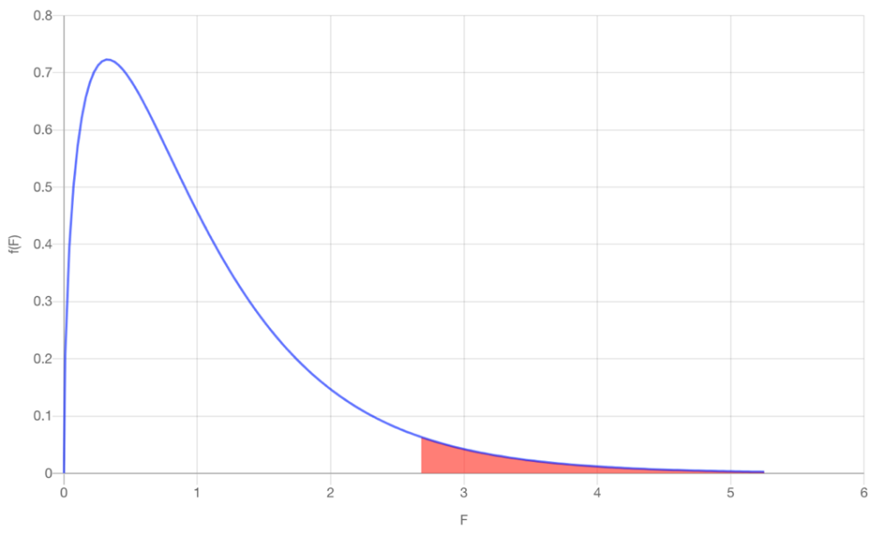
ANOVA Result Analysis
Test Statistics: The computed test statistic F equals 3.8499, which is not in the 95% region of acceptance: [-∞: 2.678].
Decision about null hypothesis: p-value equals 0.0113, [p ( x ≤ F ) = 0.988735 ]. That means, chance of type1 error (rejecting a true H0) is small: 0.0113 (1.13%). Again from sample we see, F = 3.85 > Fc​=2.678, that suggest null hypothesis is rejected
Conclusion: null hypothesis Ho is rejected for α=0.05. In other words, the difference between the averages of some groups is statistically significant. Again, from data summary we found: Means of CA + Bubble significantly higher Means of CA + Grid and VSUP + Bubble are closer Means of VSUP + Grid significantly lower Performance of CA is better than VSUP
Plot of ANOVA Results

Slide 56
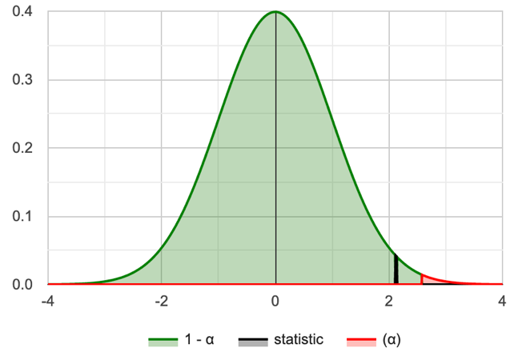
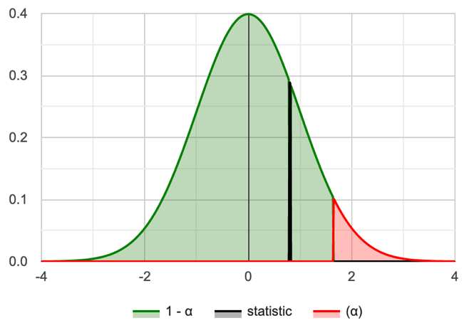
Paired t-test
Group | CA | VSUP
Mean | 5.938 | 5.422
SD | 1.105 | 1.078
SEM | 0.195 | 0.191
N | 32 | 32
Group | CA | VSUP
Skewness | -0.4622 | 0.07107
Kurtosis | -0.8658 | -0.8737
p-value | .017 | 0.017
W | 0.916 | 0.956
Data Summary
Shapiro-Wilk Normality Test
CA and VSUP normal distributions

Slide 57
t-test Results for Questionnaire
Null and Alternative Hypotheses
Ho: μ_{D​​} = (μ1​ - μ2) >= 0 (performance of CA is higher or equal to performance of VSUP) Ha: μ_{D} = ​(μ1​ - μ2) < 0 (performance of CA is less than performance of VSUP)
Rejection Region: R={t : t < −1.696} for critical value t_{c​} = −1.696
Test Statistics: t-statistic = 3.61
P-Value: p = 0.9995
Decision about the null hypothesis:
Based on t-statistic (t = 3.61 ≥ t_{c} ​= −1.696), the null hypothesis is not rejected By P-value approach (p = 0.9995 ≥ 0.05), the null hypothesis is not rejected
Conclusion: Performance of CA is higher to performance of VSUP

Slide 58
Time Utilization (TU)
Shapiro-Wilk normality tests:
For CA: W(32) = 0.959, p = 0.254
For VSUP = W(32) = 0.977, p = 0.716
Group | CA | VSUP
Mean | 8.675 | 9.647
SD | 2.320 | 3.123
SEM | 0.410 | 0.552
N | 32 | 32
Data Summary
Null and Alternative Hypotheses: Ho: μ_{D​​} = (μ1​ - μ2) <= 0 (CA response was equal or faster than VSUP response) Ha: μ_{D} = (μ1​ - μ2) > 0 (CA response was slower than VSUP response)
Rejection Region: R={t : t > 1.696}, for α = 0.05 and t_{c}​ = 1.696
Test Statistics: t-statistic = -2.656
Decision about the null hypothesis: Since t = −2.656 ≤ t_{c} ​= 1.696, the null hypothesis is not rejected Since p = 0.9938 ≥ 0.05, null hypothesis is not rejected
Conclusion: CA response was faster than VSUP response

Slide 59
T-test Results for TU
Null and Alternative Hypotheses
Ho: μ_{D​​} = (μ1​ - μ2) >= 0 (performance of CA is higher or equal to performance of VSUP) Ha: μ_{D} = ​(μ1​ - μ2) < 0 (performance of CA is less than performance of VSUP)
Rejection Region: R={t : t < −1.696} for critical value t_{c​} = −1.696
Test Statistics: t-statistic = 3.61
P-Value: p = 0.9995
Decision about the null hypothesis:
Based on t-statistic (t = 3.61 ≥ t_{c} ​= −1.696), the null hypothesis is not rejected By P-value approach (p = 0.9995 ≥ 0.05), the null hypothesis is not rejected
Conclusion: Performance of CA is higher to performance of VSUP

Slide 60
SUS Results
Group | CA | VSUP
Mean | 60.078 | 61.094
SD | 16.307 | 14.227
SEM | 2.883 | 2.515
N | 32 | 32
The Shapiro-Wilk tests shows that they do not meet normality test with the following results:
For CA: W(32) = 0.913, p = 0.013
For VSUP: W(32) = 0.889, p = 0.003
Score Calculation:
For odd items: subtract one from the user response.
For even-numbered items: subtract the user responses from 5
This scales all values from 0 to 4 (with four being the most positive response).
Add up the converted responses for each user and multiply that total by 2.5.
Range of possible values [0 to 100] instead of [0 to 40]

Slide 61
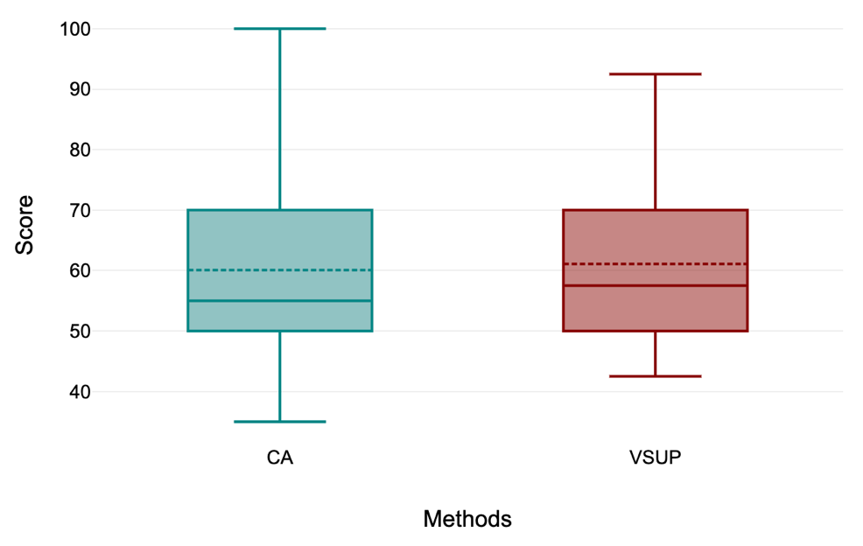
Kruskal-Wallis Test on SUS Data
Null and Alternative Hypotheses
Ho: The samples come from populations with equal medians.
Ha: The samples come from populations with medians that are not all equal.
Rejection Region: R = {χ2: χ2 > 3.841}, for df = 2 – 1 = 1, α=0.05
Test Statistics: H = 0.146
P-Value: 0.702
Decision about the null hypothesis:
Based on H-statistic (χ²=0.146 ≤ χ_{c}2​ = 3.841 ), the null hypothesis is not rejected By P-value approach (p = 0.702 ≥ 0.05 ), the null hypothesis is not rejected
Conclusion: Results do not statistically significantly vary between CA and VSUP.

Slide 62
NASA-TLX Results
Methods | NASA-TLX | Shapiro-Wilk Normality Test (α = 0.05)
 |  | Test Statistic (W) | p-value | Status
CA | Mental Demand | 0.906 | 0.009 | Not normal
 | Physical Demand | 0.914 | 0.014 | Not normal
 | Temporal Demand | 0.948 | 0.128 | Normal
 | Performance | 0.932 | 0.044 | Not normal
 | Effort | 0.942 | 0.085 | Not normal
 | Mental Frustration | 0.916 | 0.017 | Not normal
VSUP | Mental Demand | 0.863 | 0.001 | Not normal
 | Physical Demand | 0.903 | 0.007 | Not normal
 | Temporal Demand | 0.938 | 0.067 | Not normal
 | Performance | 0.887 | 0.003 | Not normal
 | Effort | 0.901 | 0.006 | Not normal
 | Mental Frustration | 0.877 | 0.002 | Not normal
Normality test results

Slide 63
Kruskal-Wallis Test on NASA-TLX Data
Null and Alternative Hypotheses
Ho: The samples come from populations with equal medians.
Ha: The samples come from populations with medians that are not all equal.
NASA-TLX | X2 | P | df | H | Conclusion
Mental Demand | 0.19 | 0.6626 | 1 | 0.19 | Not Rejected
Physical Demand | 0.062 | 0.8038 | 1 | 0.062 | Not Rejected
Temporal Demand | 0.018 | 0.8932 | 1 | 0.018 | Not Rejected
Performance | 3.61 | 0.0574 | 1 | 3.61 | Not Rejected
Effort | 0.062 | 0.8038 | 1 | 0.062 | Not Rejected
Mental Frustration | 0.173 | 0.6772 | 1 | 0.173 | Not Rejected

Slide 64
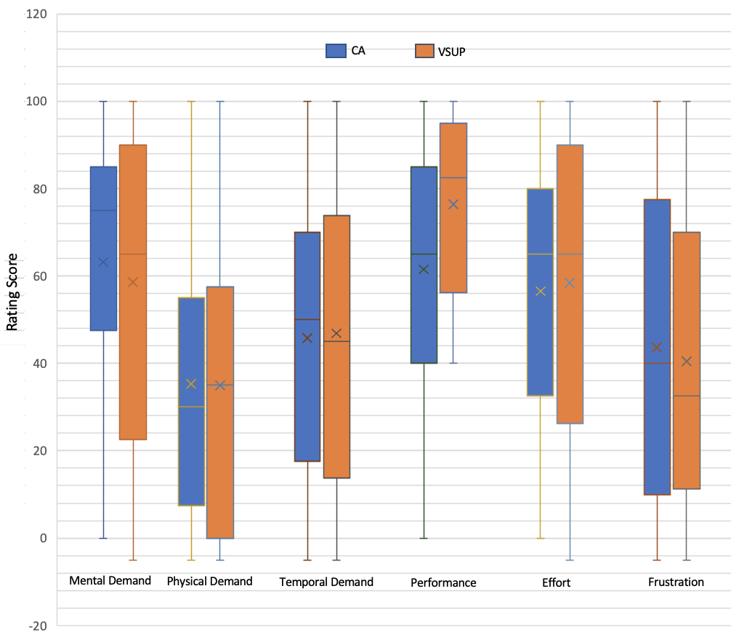
NASA-TLX Results
Conclusion: Although box-plot shows slight differences in medians but the overall results are not statistically significant.
Box Plot of six questions responses

Slide 65
Conclustions and Future Work

Slide 66
Contributions of Thesis
Implemented a new technique to represent uncertainties with three chromatic overlapping circles by using color blending in web platform.
The CA approach uncertainty representation outperforms an state-of-the-art mechanism VSUP.
Applied CA on some real life charts like World Map, Bubble chart, Stream Graph, Star-fish Layout, etc.
Prepared a journal and planning to submit for publication in ACM.

Slide 67
Conclusion
User performance and perception for CA statistically surpasses VSUP.
CA is faster than VSUP in terms of task completion time by the users.
Subjective assessments show that both CA and VSUP are statistically similar.

Slide 68
Future work
A further study could be conducted with more levels uncertainties for instance, with 8 levels instead of 4 levels of uncertainties.
The role of CA might also be explored and studied with animated visualization.
Other future work may refine and expand upon some of our other experimental designs such as Starfish layout streamgraph.

Slide 69
Questions?

Slide 70
References
Michael Correll, Dominik Moritz, Jeffrey Heer. Value-Suppressing Uncertainty Palettes. Proceedings of the 2018 CHI Conference on Human Factors in Computing Systems. April 2018. Paper No.: 642 Pages 1–11.
Song, Xin; Xiao, Jun PhD; Deng, Jiang PhD; Kang, et al. Time series analysis of. influenza incidence in Chinese provinces from 2004 to 2011. Received March 1, 2016, Accepted May 20, 2016, Medicine: June 2016 - Volume 95 - Issue 26 - p e3929
Christophorus Beneditto, Aditya Satrio et al. Time series analysis and forecasting of coronavirus disease in Indonesia using ARIMA model and PROPHET, https://doi.org/10.1016/j.procs.2021.01.036
Stéfan van der Walt and Nathaniel Smith. 2015. Mpl colormaps. https://bids.github.io/colormap/, (2015).
Keppel, Geoffrey: Design and Analysis, 3rd Edition. Prentice-Hall.

Slide 71
References
M. K. Johnson & H. Farid. 2006. Exposing digital forgeries through chromatic aberration. Multimedia and security, Geneva, Switzerland, 48-55
Aasim Kamal · Parashar Dhakal, et al. Recent advances and challenges in uncertainty visualization: a survey. May 2021, Journal of Visualization 24(5):1-30.
Shapiro, S. S.; Wilk, M. B. (1965). "An analysis of variance test for normality (complete samples)". Biometrika. 52 (3–4): 591–611. Stéfan van der Walt and Nathaniel Smith. 2015. Mpl colormaps. https://bids.github.io/colormap/, (2015).
Henning Griethe et al. The Visualization of Uncertain Data: Methods and Problems. Computer Graphics, 18051 Rostock, Germany. January 2006, 2,988 reads, 36 publications, 262 citations.
Pang, A., Wittenbrink, C., Lodha., S.: Approaches to uncertainty visualization. The Visual Computer 13(8), 370–390 (1997).
R. Finger and A. M. Bisantz. Utilizing graphical formats to convey uncertainty in a decision-making task. Theoretical Issues in Ergonomics Science, 3(1):1–25, 2002

Slide 72
References
K. Koh, B. Kim & J. Seo. 2014. Effect of lateral chromatic aberration for chart reading in information visualization on display devices. Advanced Visual Interfaces. Como, Italy, 289-292
M. K. Johnson & H. Farid. 2006. Exposing digital forgeries through chromatic aberration. Multimedia and security, Geneva, Switzerland, 48-55.
Deitrick, S., Edsall, R.: The influence of uncertainty visualization on decision making: An empirical evaluation. In: Progress in Spatial Data Handling, pp. 719–738. Springer Berlin Heidelberg (2006).
Aasim Kamal · Parashar Dhakal, et al. Recent advances and challenges in uncertainty visualization: a survey. May 2021, Journal of Visualization 24(5):1-30.

